Slide 1
G-MART
Team:
Shivani Kolanu (002647623)
Sai Subhash Manam (002695146)
Sujit Reddy Gaddam (002713345)

Slide 2
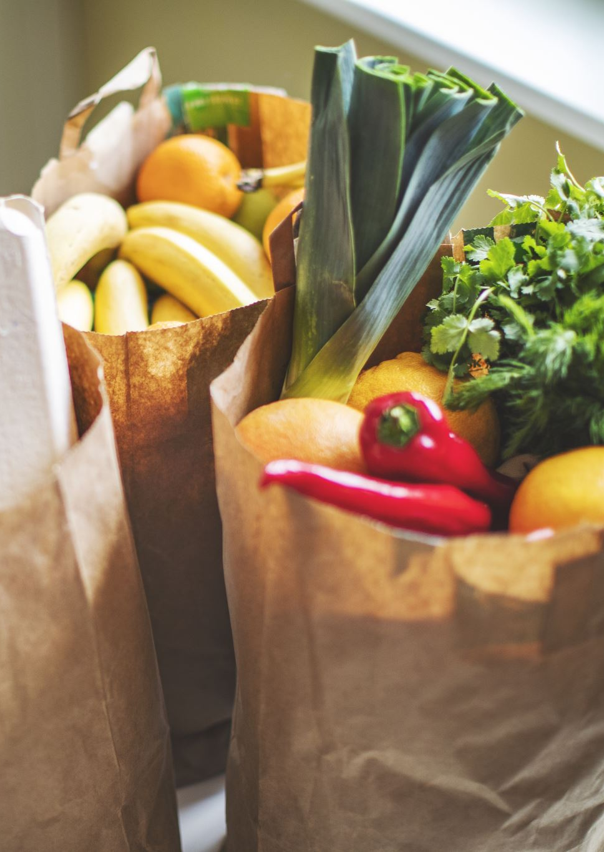
OUTLINE
G-Mart is an online grocery management system, intended to provide comfort and convenance to the customers, by providing a way to order the groceries from the comfort of their homes.

Slide 3
ABSTRACT
G-Mart provides user-friendly interface for people who want to buy groceries online and get them delivered home. On an everyday basis, people have to use a grocery shop to get their livelihood items. To buy the necessary products, people visit a grocery shop to collect the products from different shelves and then pay for the items and checkout. But many times, this process does not seem very convenient. In their busy schedule they always forget to make time for grocery shopping.

Slide 4
Introduction
In this web application, user need to login into the application in order to buy and get the items delivered. Users can add the items into the cart and finally check out when ready. Users will also have an option to add items to the cart and come back later to buy them. All these functionalities would be handled backend in the database where it will consist of different tables and different schemas. The database is going to play a vital role in this web application as it makes it possible for end users to create, protect, read, update and delete data systematically.

Slide 5
DESIGN

Slide 6
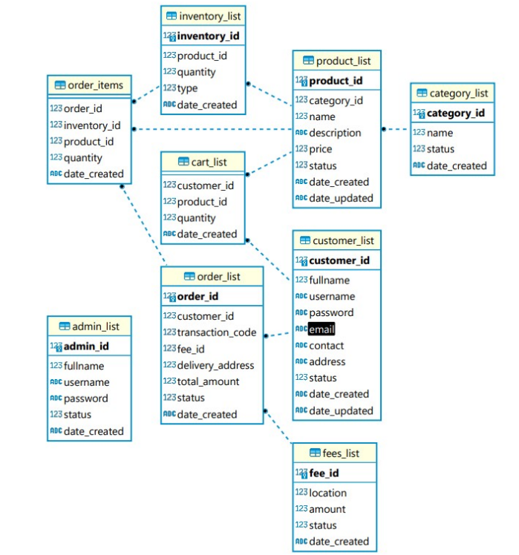
Schema Diagram

Slide 7
Design Tools
XAMPP
SQLite
DBeaver
HTML
CSS
PHP
JavaScript

Slide 8
Implementation
The Admin and Customer modules make up the two sections of this web application. G-Mart can handle all of their products, stocks, and customer orders using the Admin Module on the system side. Customers and visitors can browse, explore, add things to their carts, and place orders on the Customer Module side of the website. The system will automatically add a delivery fee to the total that the consumer must pay at delivery when they check out.

Slide 9
Admin Module Features:
Secure Login
Home Page
Manage Category List
Manage Product List
Regulate Order List
Regulate Customer List
Manage Users List
Regulate Account Credentials
Logout

Slide 10
Customer Module Features:
Secure Login and Registration
List Search Products
Add Product to Shopping Cart
Checkout
List all Orders View orders
Manage Account Credentials
Logout

Slide 11

Demo

Slide 12
Conclusion
Consumers now have access to technology that offers a superior online grocery shopping experience, and this trend will only increase in the future. The accessibility of online purchasing has resulted in a better informed consumer who can compare and shop quite easily, without having to invest a lot of time. Thanks to online grocery shopping as many small shops that would never be in business now have access to an excellent market for their business.

Slide 13
Thank you
Team:
Shivani Kolanu (002647623)
Sai Subhash Manam (002695146)
Sujit Reddy Gaddam (002713345)

